Slide 1
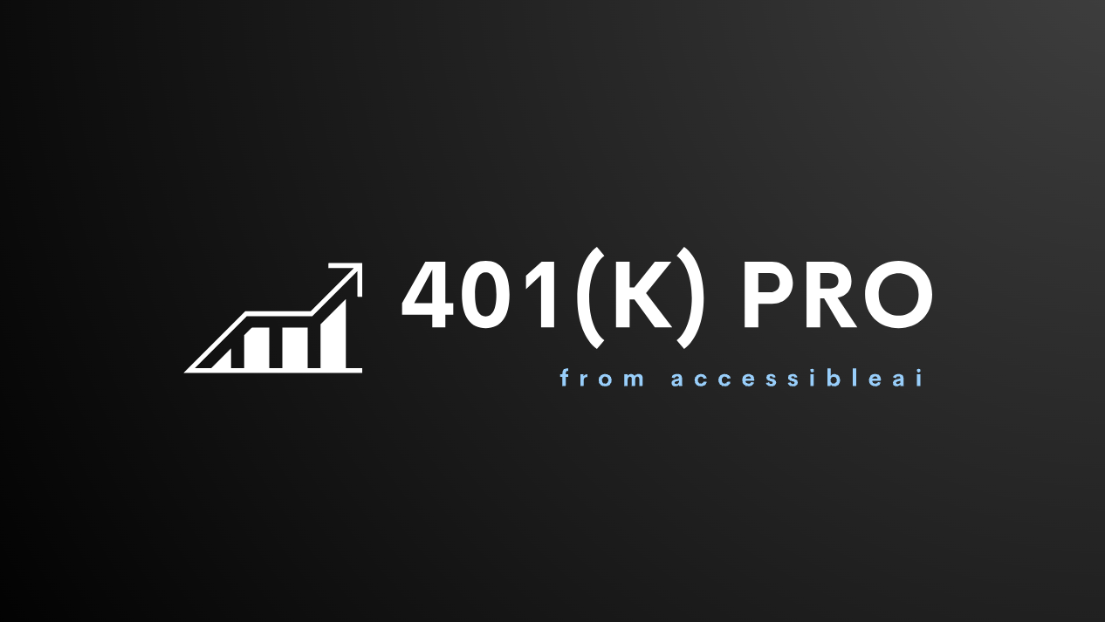

Slide 2
Qualified 401(K) Planners are in Trouble
Advisors are leaving 401(K) planning because:
Reporting takes too long to complete
It is extremely difficult to navigate ever changing regulations
Given time requirements it is less profitable than traditional financial planning
It is extremely difficult to train junior employees to help with the planning process
There is no purpose built solution to help qualified 401(K) planners manage their 401(K) plans

Slide 3
Sacrifice Quality or Reduce Profitability
The questions all advisors are currently asking themselves:
Do I spend time to retain professional level quality for my 401(K) plans or save time and lower the quality of my 401(K) planning so that I can make more money?

Slide 4
401(K) Planners Have Been Ignored For Too Long
No CRMS specifically built for keeping track of 401(K) planning information
No platform to automate plan quarterly and annual plan compliance reporting
Immeasurable amounts of regulation from ERISA, FINRA, DOL, etc. that is impossible to keep up with
Extremely difficult to train junior employees for how to keep plans compliant

Slide 5



How Advisors Currently Have To Track of 401(K) Plans
Scattered Information
Hand Write Reports
Guess About Compliance
Storing information in 100 different CRMs, emails, client files making it impossible to find the information you need when you need it
Spending weeks writing quarterly and annual 401(K) compliance reports for each client.
Trying desperately to navigate through the endless stream of regulation from ERISA, FINRA, and the DOL only to find that it completely overwhelming

Slide 6
It’s 2024… You deserve better

Slide 7
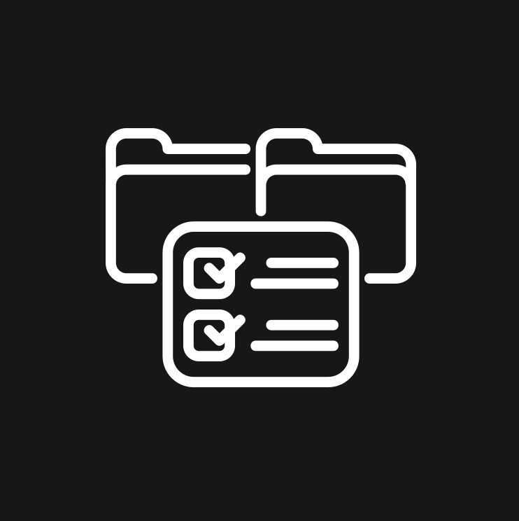
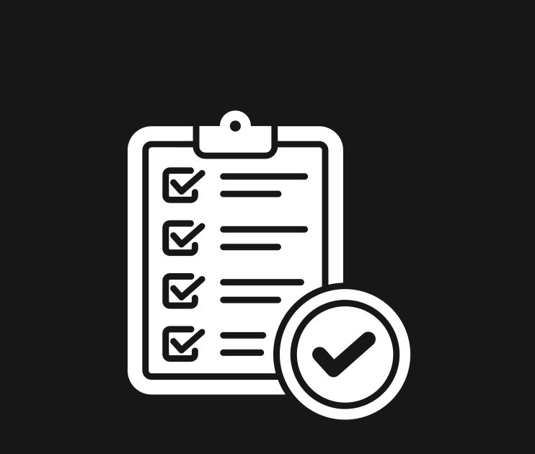

How 401(K) Planning Is With 401(K) Pro
All relevant plan information in one place
Write compliance reports with 1 click
Easily make sure your plans are compliant
Keep all of your relevant 401(K) plan information in one easy to access location, so that it is at your fingertips whenever you need it
At the end of the quarter or year when you are ready to send your 401(K) reports, click 1 button and all your reports and professionally written for you in under 15 seconds
Just follow 401(K) Pro’s in built agenda to make sure that your plans stay compliant. It is really that easy.

Slide 8
So What is 401(K) Pro
A purpose-built CRM and reporting tool for Qualified 401(K) Planners
Advisors track actions that they take for their 401(K) plans and requirements that their clients need to complete to stay compliant
At the end of the quarter 401(K) pro automatically writes 401(K) plans for you based upon the information you logged throughout the quarter

Slide 9
What is Covered in 401(K) Pro Reports
General Market Overview: Automatically written overview of market conditions for the reporting quarter or year
Plan Management Checklist: Compliance steps to be followed by TPA, Record Keepers, and Clients to make sure that a plan stay compliant
Plan Notes For Quarter: Actions taken by the advisor throughout the quarter highlighting the work that you did for a plan
Mark Performance: Quantitative overview of general market performance in the reporting quarter or year

Slide 10
Coming AI Features and Integrations

Slide 11



35 Years of 401(K) Experience Supercharged By Gen-Z
Ed Secrest
President, AccessibleAI 401(K) Pro
Cameron Abernethy
Co-Founder and CEO, AccessibleAI
Tahmid Awal
Co-Founder and CTO, AccessibleAI

Slide 12
Coming AI Features and Integrations
Quarterly and Annual 401(K) Reports
Plan Compliance Checklist
Plan Notes For Quarter
Advisor Service Schedule

Slide 13
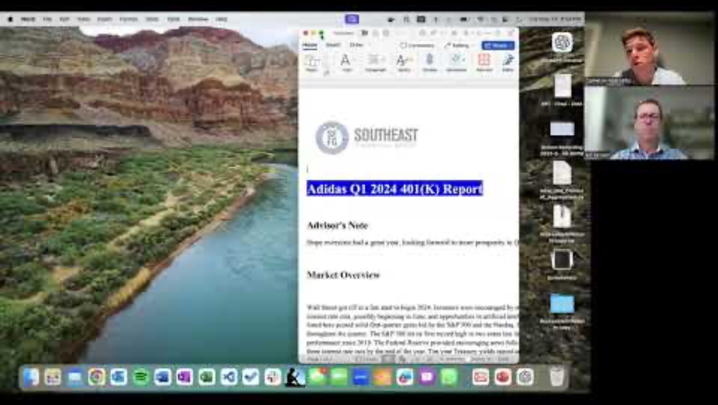
Demo – 14 Minutes

